Slide 1
Building Entity

Slide 2
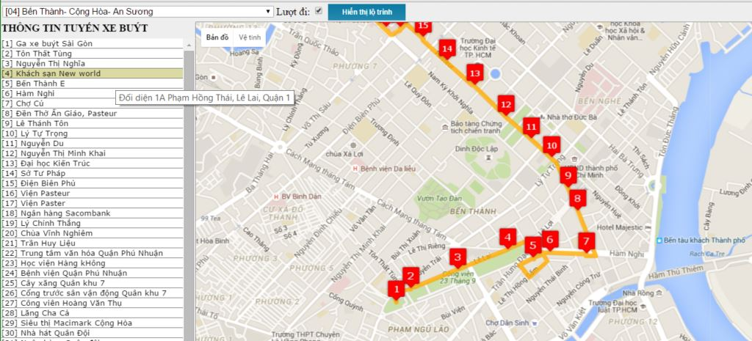
BUSES ROUTE INFORMATION
http://route.buyttphcm.com.vn/routeoftrunk.aspx

Slide 3
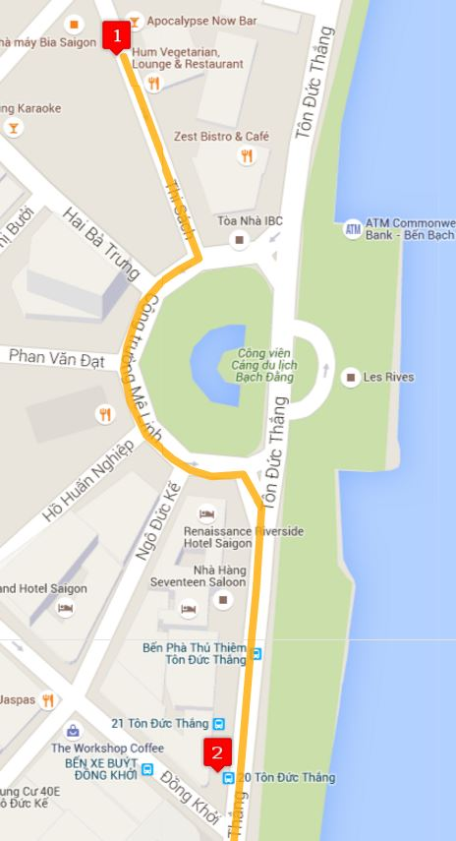
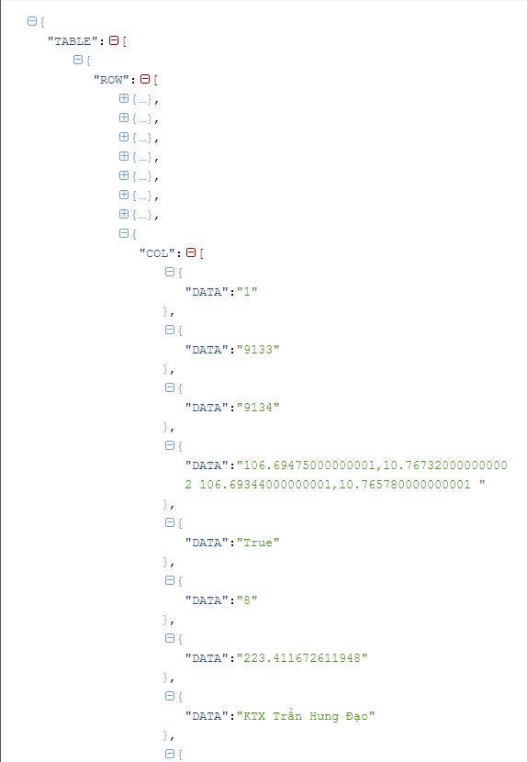
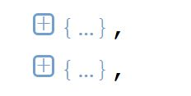
http://mapbus.ebms.vn/ajax.aspx?action=listRouteStations&rid=1&isgo=true

Slide 4
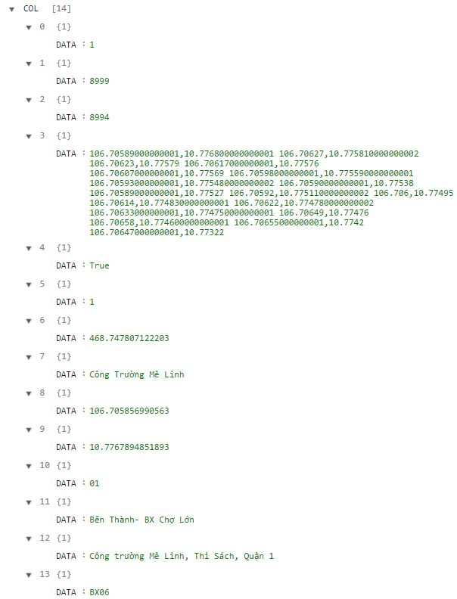
http://mapbus.ebms.vn/ajax.aspx?action=listRouteStations&rid=1&isgo=true

Slide 5
Index | Sample value | Attribute
0 | 1 | Route’s id
1 | 8999 | Stop station’s ID
2 | 8994 | Stop station’s ID
3 | 106.70589000000001,10.776800000000001 | Middle points
4 | True | Turn (isgo parameter)
5 | 1 | Order in route
6 | 468.747807122203 | Distance
7 | Công Trường Mê Linh | Start station’s name
8 | 106.705856990563 | Start station’s longitude
9 | 10.7767894851893 | Start station’s latitude
10 | 01 | Bus number
11 | Bến Thành- BX Chợ Lớn | Bus name
12 | Công trường Mê Linh, Thi Sách, Quận 1 | Start station’s address
13 | BX06 | Start station’s code
http://mapbus.ebms.vn/ajax.aspx?action=listRouteStations&rid=1&isgo=true

Slide 6
ROUTE
Route: represent the route of bus.

Slide 7
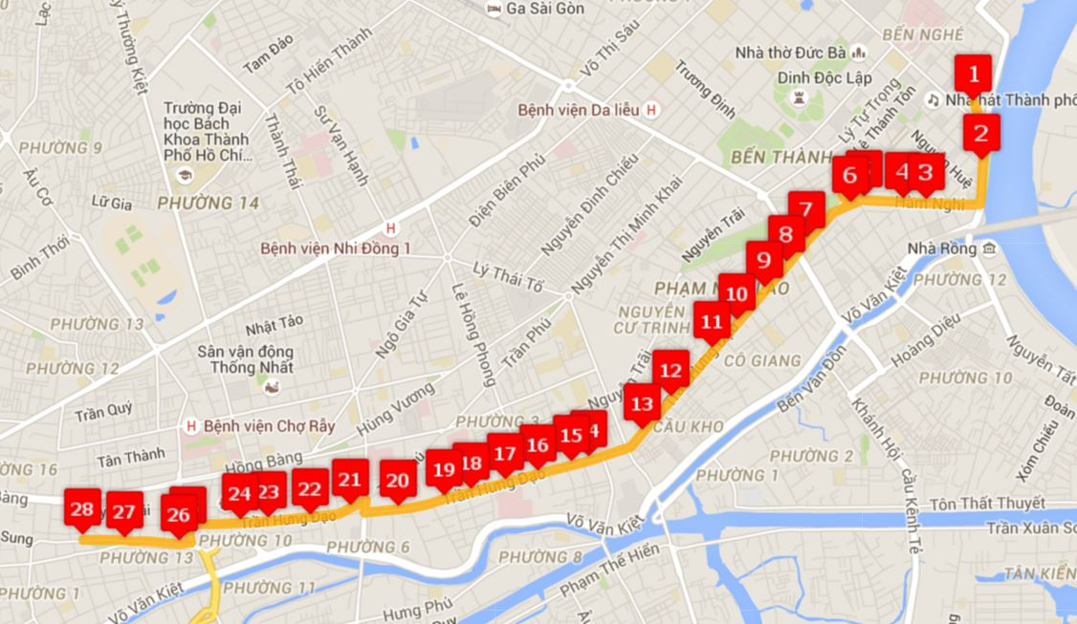

Slide 8
Index | Sample value
0 | 1
1 | 8999
2 | 8994
3 | 106.70589000000001,10.776800000000001 106.70627,10.775810000000002 106.70623,10.77579 106.70617000000001,10.77576 ...
4 | True
5 | 1
6 | 468.747807122203
7 | Công Trường Mê Linh
8 | 106.705856990563
9 | 10.7767894851893
10 | 01
11 | Bến Thành- BX Chợ Lớn
12 | Công trường Mê Linh, Thi Sách, Quận 1
13 | BX06
Route
RouteType
http://mapbus.ebms.vn/ajax.aspx?action=listRouteStations&rid=1&isgo=true

Slide 9
Index | Sample value
0 | 1
1 | 8999
2 | 8994
3 | 106.70589000000001,10.776800000000001 106.70627,10.775810000000002 106.70623,10.77579 106.70617000000001,10.77576 ...
4 | True
5 | 1
6 | 468.747807122203
7 | Công Trường Mê Linh
8 | 106.705856990563
9 | 10.7767894851893
10 | 01
11 | Bến Thành- BX Chợ Lớn
12 | Công trường Mê Linh, Thi Sách, Quận 1
13 | BX06
Route
RouteType
RouteNo
http://mapbus.ebms.vn/ajax.aspx?action=listRouteStations&rid=1&isgo=true

Slide 10
Index | Sample value
0 | 1
1 | 8999
2 | 8994
3 | 106.70589000000001,10.776800000000001 106.70627,10.775810000000002 106.70623,10.77579 106.70617000000001,10.77576 ...
4 | True
5 | 1
6 | 468.747807122203
7 | Công Trường Mê Linh
8 | 106.705856990563
9 | 10.7767894851893
10 | 01
11 | Bến Thành- BX Chợ Lớn
12 | Công trường Mê Linh, Thi Sách, Quận 1
13 | BX06
Route
RouteType
RouteNo
RouteName
http://mapbus.ebms.vn/ajax.aspx?action=listRouteStations&rid=1&isgo=true

Slide 11
STATION
Station: represent the station of bus

Slide 12
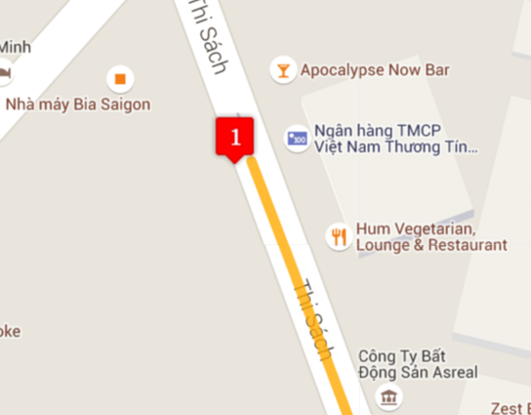

Slide 13
Index | Sample value
0 | 1
1 | 8999
2 | 8994
3 | 106.70589000000001,10.776800000000001 106.70627,10.775810000000002 106.70623,10.77579 106.70617000000001,10.77576 ...
4 | True
5 | 1
6 | 468.747807122203
7 | Công Trường Mê Linh
8 | 106.705856990563
9 | 10.7767894851893
10 | 01
11 | Bến Thành- BX Chợ Lớn
12 | Công trường Mê Linh, Thi Sách, Quận 1
13 | BX06
Station
CodeID
http://mapbus.ebms.vn/ajax.aspx?action=listRouteStations&rid=1&isgo=true

Slide 14
Index | Sample value
0 | 1
1 | 8999
2 | 8994
3 | 106.70589000000001,10.776800000000001 106.70627,10.775810000000002 106.70623,10.77579 106.70617000000001,10.77576 ...
4 | True
5 | 1
6 | 468.747807122203
7 | Công Trường Mê Linh
8 | 106.705856990563
9 | 10.7767894851893
10 | 01
11 | Bến Thành- BX Chợ Lớn
12 | Công trường Mê Linh, Thi Sách, Quận 1
13 | BX06
Station
CodeID
Street
http://mapbus.ebms.vn/ajax.aspx?action=listRouteStations&rid=1&isgo=true

Slide 15
Index | Sample value
0 | 1
1 | 8999
2 | 8994
3 | 106.70589000000001,10.776800000000001 106.70627,10.775810000000002 106.70623,10.77579 106.70617000000001,10.77576 ...
4 | True
5 | 1
6 | 468.747807122203
7 | Công Trường Mê Linh
8 | 106.705856990563
9 | 10.7767894851893
10 | 01
11 | Bến Thành- BX Chợ Lớn
12 | Công trường Mê Linh, Thi Sách, Quận 1
13 | BX06
Station
CodeID
Street
Latitude
http://mapbus.ebms.vn/ajax.aspx?action=listRouteStations&rid=1&isgo=true

Slide 16
Index | Sample value
0 | 1
1 | 8999
2 | 8994
3 | 106.70589000000001,10.776800000000001 106.70627,10.775810000000002 106.70623,10.77579 106.70617000000001,10.77576 ...
4 | True
5 | 1
6 | 468.747807122203
7 | Công Trường Mê Linh
8 | 106.705856990563
9 | 10.7767894851893
10 | 01
11 | Bến Thành- BX Chợ Lớn
12 | Công trường Mê Linh, Thi Sách, Quận 1
13 | BX06
Station
CodeID
Street
Latitude
Longitude
http://mapbus.ebms.vn/ajax.aspx?action=listRouteStations&rid=1&isgo=true

Slide 17
Index | Sample value
0 | 1
1 | 8999
2 | 8994
3 | 106.70589000000001,10.776800000000001 106.70627,10.775810000000002 106.70623,10.77579 106.70617000000001,10.77576 ...
4 | True
5 | 1
6 | 468.747807122203
7 | Công Trường Mê Linh
8 | 106.705856990563
9 | 10.7767894851893
10 | 01
11 | Bến Thành- BX Chợ Lớn
12 | Công trường Mê Linh, Thi Sách, Quận 1
13 | BX06
Station
CodeID
Street
Latitude
Longitude
Name
http://mapbus.ebms.vn/ajax.aspx?action=listRouteStations&rid=1&isgo=true

Slide 18
PATHINFO
PathInfo: represent the path between two stations

Slide 20
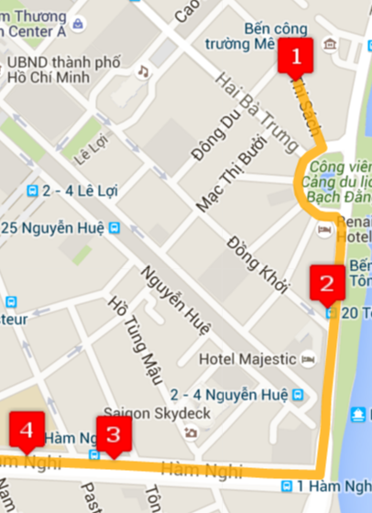
Index | Sample value
0 | 1
1 | 8999
2 | 8994
3 | 106.70589000000001,10.776800000000001 106.70627,10.775810000000002 106.70623,10.77579 106.70617000000001,10.77576 ...
4 | True
5 | 1
6 | 468.747807122203
7 | Công Trường Mê Linh
8 | 106.705856990563
9 | 10.7767894851893
10 | 01
11 | Bến Thành- BX Chợ Lớn
12 | Công trường Mê Linh, Thi Sách, Quận 1
13 | BX06
PathInfo
PathInfoNo
1
2
3
http://mapbus.ebms.vn/ajax.aspx?action=listRouteStations&rid=1&isgo=true

Slide 21
Index | Sample value
0 | 1
1 | 8999
2 | 8994
3 | 106.70589000000001,10.776800000000001 106.70627,10.775810000000002 106.70623,10.77579 106.70617000000001,10.77576 ...
4 | True
5 | 1
6 | 468.747807122203
7 | Công Trường Mê Linh
8 | 106.705856990563
9 | 10.7767894851893
10 | 01
11 | Bến Thành- BX Chợ Lớn
12 | Công trường Mê Linh, Thi Sách, Quận 1
13 | BX06
PathInfo
PahtInfoNo
MiddlePoints
http://mapbus.ebms.vn/ajax.aspx?action=listRouteStations&rid=1&isgo=true

Slide 22
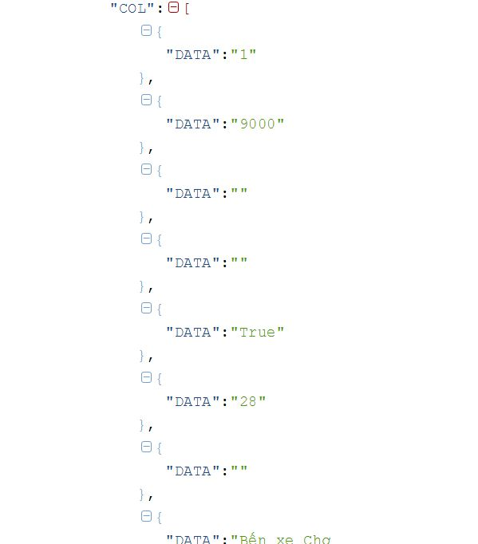
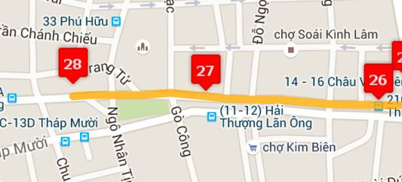

Slide 23



Station
CodeID
Street
Latitude
Longitude
Name
PathInfo
FromStationID
ToStationID
RouteID
PahtInfoNo
MiddlePoints
Route
RouteType
RouteNo
RouteName
$$∞$$
start
1
1
includes
$$∞$$
$$∞$$
stop
0..1

Slide 24
TRIP
Trip: represent start time and end time of route.

Slide 25
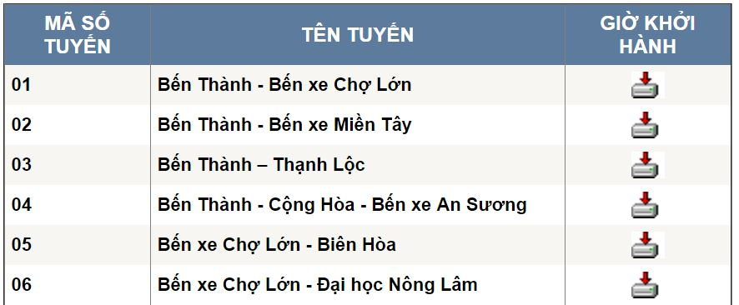
BUSES TRIP INFORMATION
http://buyttphcm.com.vn/TTLT.aspx

Slide 26
Route
RouteType
RouteNo
RouteName
http://buyttphcm.com.vn/TTLT.aspx

Slide 27
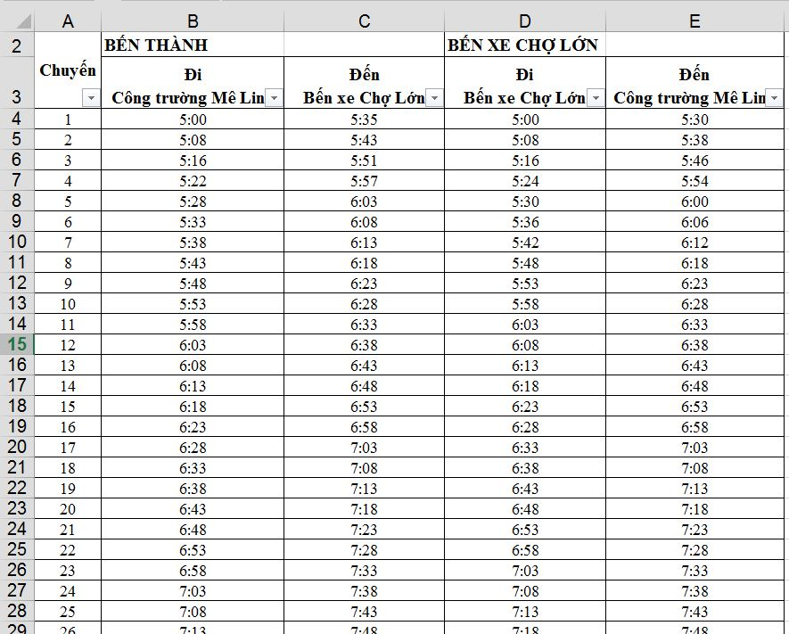
Time of route depart
Time of route return

Slide 28

Route
RouteType
RouteNo
RouteName
1
includes
$$∞$$
Trip
RouteID
Time of route depart
Time of route return

Slide 29
Time of route depart
Time of route return
Trip
RouteID
TripNo

Slide 30
Time of route depart
Time of route return
Trip
RouteID
TripNo
StartTime

Slide 31
Time of route depart
Time of route return
Trip
RouteID
TripNo
StartTime
EndTime

Slide 32




Station
CodeID
Street
Latitude
Longitude
Name
PathInfo
FromStationID
ToStationID
RouteID
MiddlePoints
PathInfoNo
Route
RouteType
RouteNo
RouteName
$$∞$$
start
1
1
includes
$$∞$$
$$∞$$
stop
1
1
includes
$$∞$$
Trip
RouteID
TripNo
StartTime
EndTime

